Slide 1

The General’s Hackathon
Team 8 Presentation

Slide 2
The General’s Hackathon
Topic: HSE Walkabout and Digital Solution
Using TP as a case study

Slide 3
Team Members:
Product Owner: Yusuf Dauda
Scrum Master: Nelly Halliday
DevOps Members: Ike Ejike
James Okere
Team Members: Vera Ogulu
Amuno Uzezi
The General’s Hackathon

Slide 4
AIM :
To identify problem areas around HSE Walkabout and proffer digital solutions.
To keep track of HSE walkabout to avoid repetition and loss of data.
Instant update on the dashboard and visibility of report.
Automation of data input.
The General’s Hackathon

Slide 5
Identified problems:
Data not properly structured
Manual updating of data
Updates not visible to all team members
Error free tracking of jobs done
Paper based walkabout inspection report.
Manual updating of reports
Increased man hour in generating reports
Solution1:
Creating a structured database to minimize data redundancy and duplication
Automated dashboard
Updates Visibility to all Users
Creating an online app for instant collation and reporting of HSE walkabout.
The General’s Hackathon

Slide 6
Q4 2022
Create a structured database
Q1 2023
Deployment of the App.
Q2 2023
Q3 2023
Develop a digital App.
To create a Power BI dashboard and report
Inclusion of instant messaging and notification
Create a mobile version of the App.
The General’s Hackathon

Slide 7
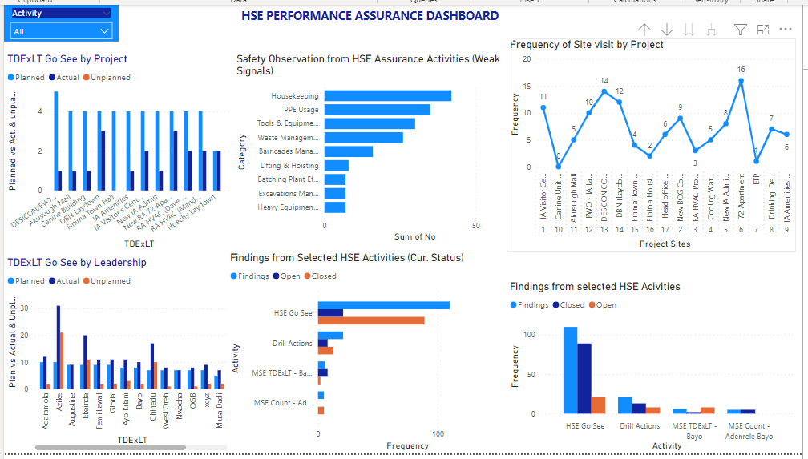
The General’s Hackathon

Slide 8
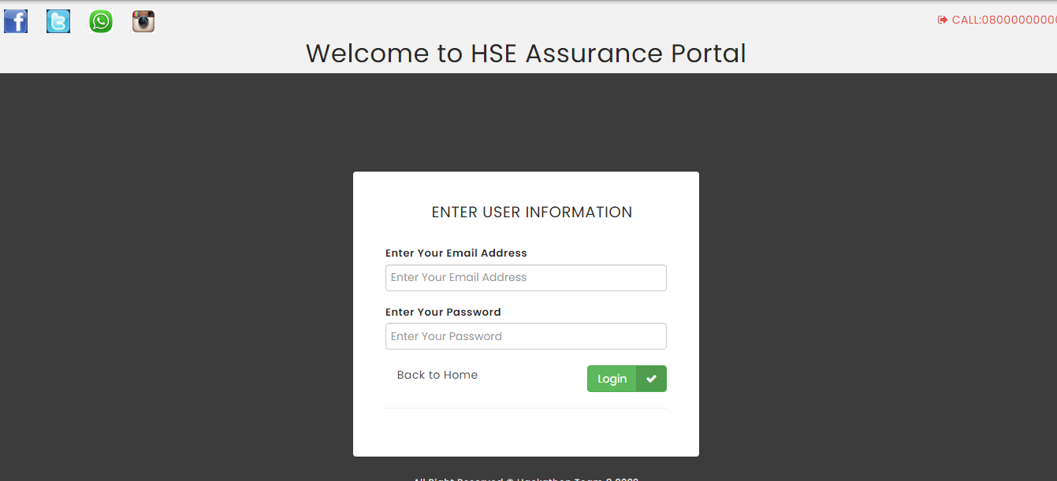
The General’s Hackathon

Slide 9
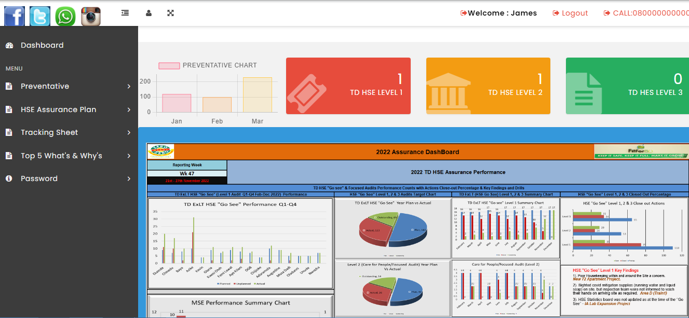
The General’s Hackathon

Slide 10
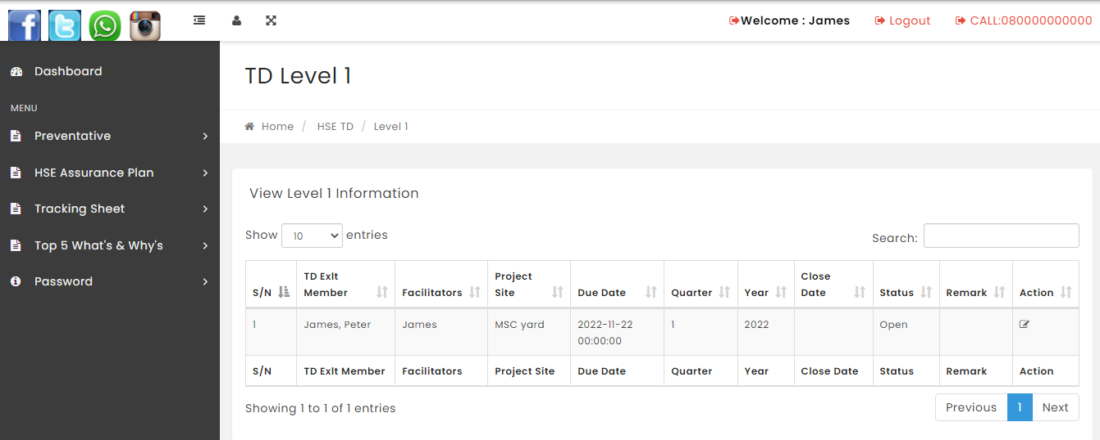
The General’s Hackathon

Slide 11
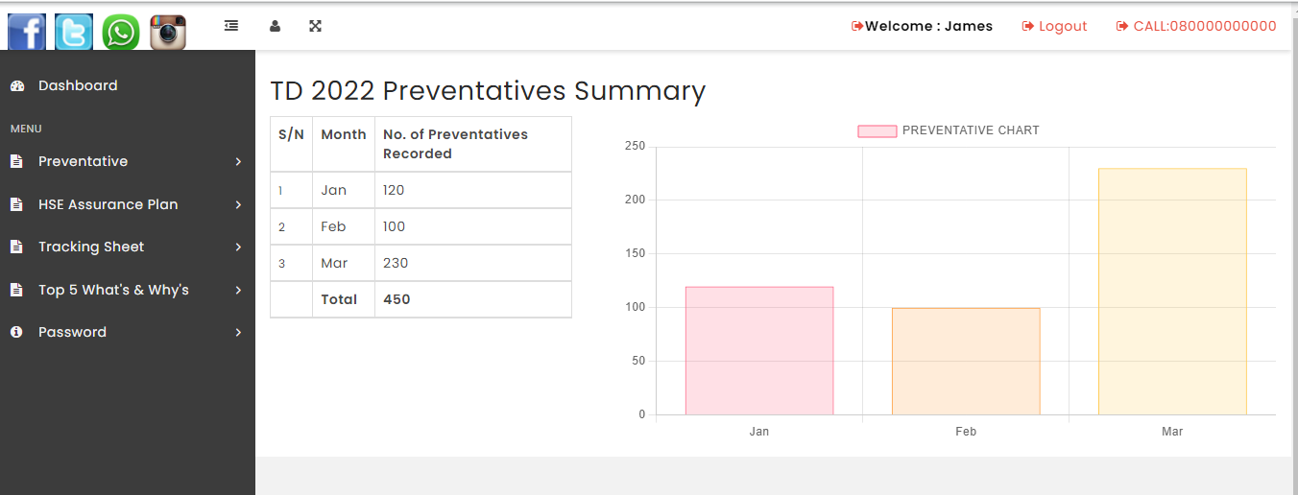
The General’s Hackathon

Slide 12

…helping to build a better Nigeria

